Slide 1



Home
Photo
About Us
Contact
Advance Web Technology
CRUD Application in JS, AJAX, Bootstrap

Slide 2
Home
Photo
About Us
Contact
CRUD Application in JS
01
CRUD Operation in JS?
02
Why we use CRUD Operation
03
CRUD Application Output
04
HTML Code
05
JS Code
HADIA QAISER 003

Slide 3




Home
Photo
About Us
Contact
CRUD Operation in JS
CRUD stands for Create, Read, Update, and Delete. In the context of JavaScript, It refers to the basic actions that can be performed on data.
CREATE
READ
UPDATE
DELETE
3

Slide 4


Home
Photo
About Us
Contact
Why we use CRUD Operation
These operations are fundamental in most applications as they allow manipulation of data, which is at the core of almost every software system. CRUD operations are essential for building interactive, data-driven applications that provide users with the ability to manage and manipulate data effectively.
INTERACTIVE
DATA-DRIVEN
4

Slide 5
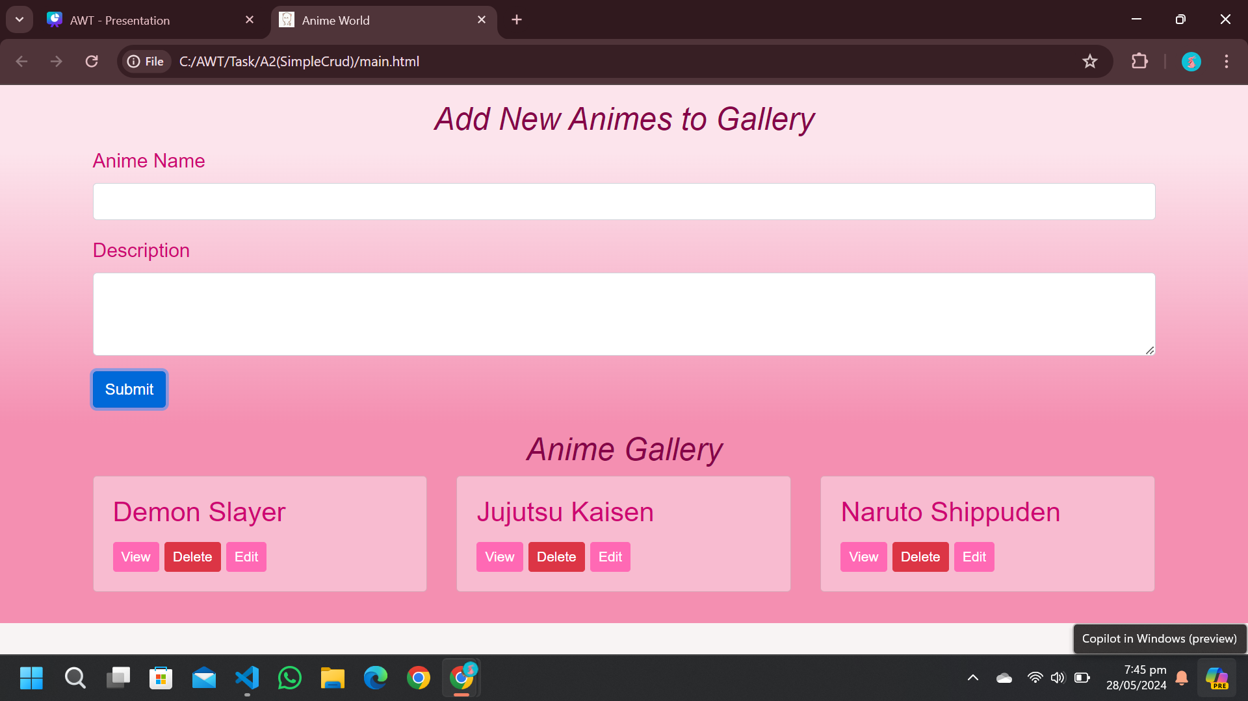
Home
Service
About Us
Contact
CRUD Application Output
5

Slide 6
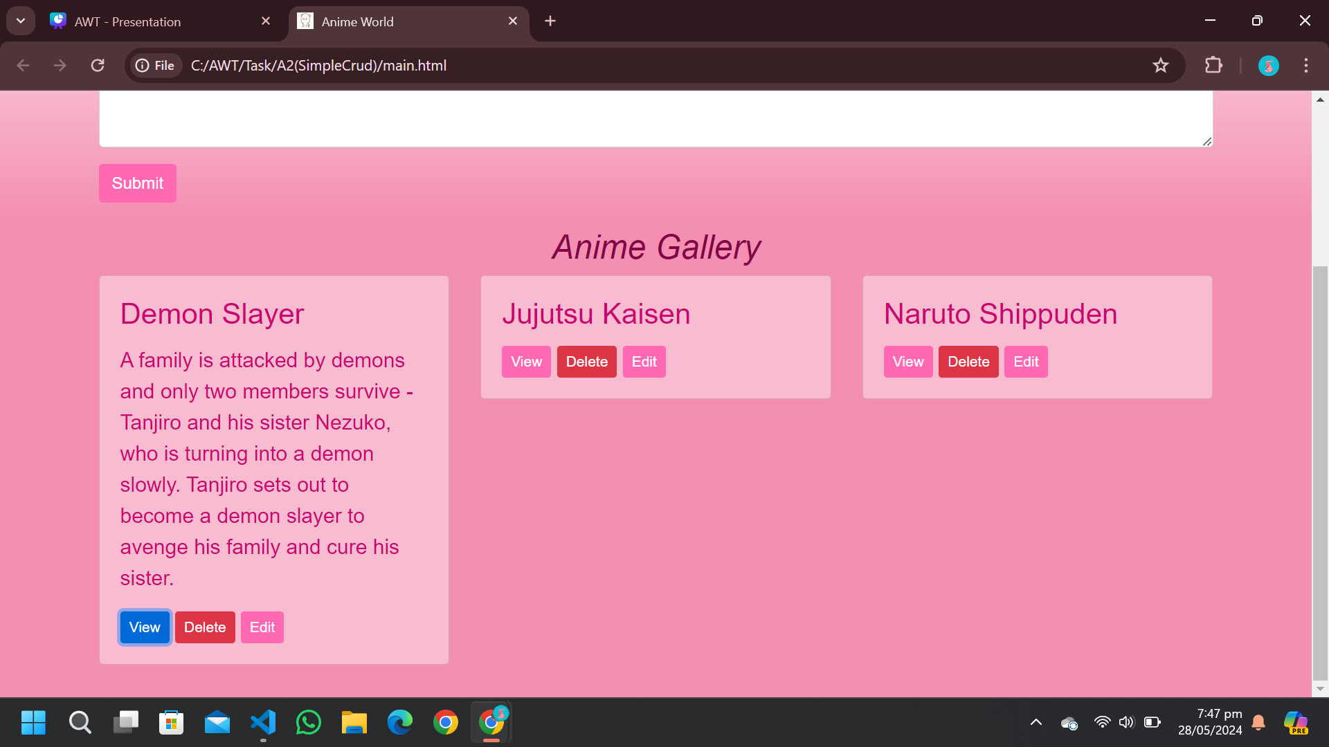
Home
Service
About Us
Contact
CRUD Application Output
6

Slide 7

Home
Photo
About Us
Contact
HTML Code
<section>: Defines a section of the webpage for the form.
<div>: A container to center content and apply a fixed width.
<h2>: A heading for the form title.
<form>: The form element.
<div>: A form group for the anime name.
<label>: A label for the anime name input.
<input type="text">: A text input for the anime name.
<div>: A form group for the anime description.
<label>: A label for the anime description textarea.
<textarea>: A text area for the anime description.
<button>: A submit button for the form.
7

Slide 8

Home
Photo
About Us
Contact
JS Code
Prevent Default Behavior and Retrieve Form Data
function handleFormSubmission(e) {
e.preventDefault();
const form = e.target;
const animeId = form.animeId.value;
const animeName = form.animeName.value;
const animeDescription = form.animeDescription.value;
Prevent default form submission behavior
Retrieves the form element that triggered the event
Extracts values for animeId, animeName, and animeDescription from form
8

Slide 9
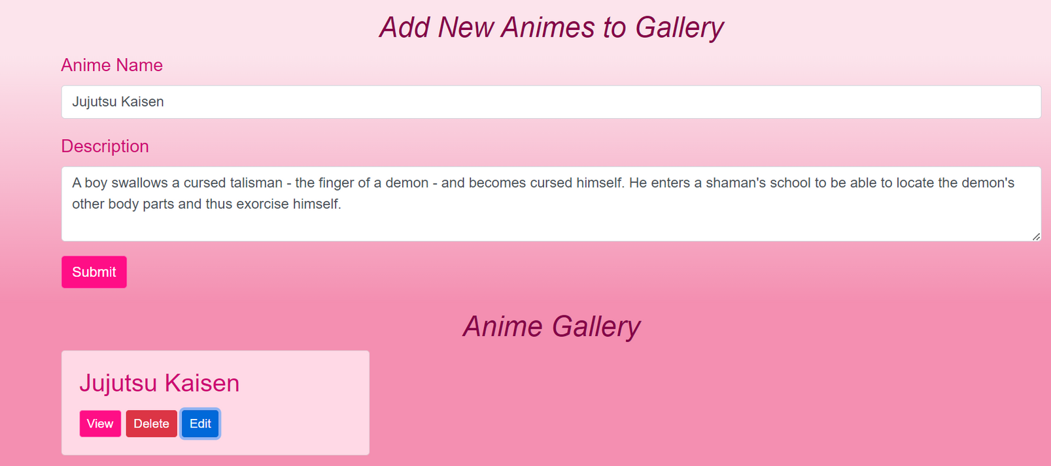
Home
Photo
About Us
Contact
JS Code
Check if Anime ID Exists than Update existing anime card
if (animeId) {
const existingAnimeCard = document.getElementById(animeId);
existingAnimeCard.querySelector('.card-title').innerText = animeName;
existingAnimeCard.querySelector('.card-description').innerText = animeDescription;}
If animeId exists, it implies the form is updating an existing anime card.
It fetches the existing card by animeId and updates its title and description
9

Slide 10
Home
Photo
About Us
Contact
JS Code
Else Create new anime card and append to row inside portfolio section
else {
const animeCard = document.createElement('div');
animeCard.id = Date.now(); // Unique ID for each anime card
animeCard.innerHTML = `
<div class="card mb-4">
<h3 class="card-title">${animeName}</h3>
<p class="card-description" style="display: none;">${Description}</p>
<button class="btn btn-primary btn-sm view">View</button>
<button class="btn btn-danger btn-sm delete">Delete</button>
<button class="btn btn-primary btn-sm edit">Edit</button>
document.getElementById('portfolio').querySelector('.row').appendChild(animeCard);
10

Slide 11

Home
Photo
About Us
Contact
JS Code
Clear Form for new inputs
form.reset();
form.animeId.value = '';
Finally, the form is reset to clear all input fields, and the animeId field is cleared to reset the form for a new entry.
11

Slide 12
Photo
About Us
Contact
JS Code
Function to delete, view or edit anime card
function handleCardAction(e) { const cardBody = e.target.parentElement;
// Get the parent element of the clicked button
(card body)const animeId = cardBody.parentElement.parentElement.id;
// Get the anime card's ID
const action = e.target.classList.contains('delete') ? 'delete' :
e.target.classList.contains('edit') ? 'edit' : 'view';
// Determine the action (delete, edit, or view)
12

Slide 13
Photo
About Us
Contact
JS Code
Function to delete, view or edit anime card
if (action === 'delete') {
cardBody.parentElement.parentElement.remove();}
else if (action === 'edit') {
const animeName = cardBody.querySelector('.card-title').innerText;
const animeDescription = cardBody.querySelector('.card description').innerText;
else {
const description = cardBody.querySelector('.card-description');
description.style.display = description.style.display === 'none' ? 'block' : 'none';}
13

Slide 14
Contact
JS Code
Event Listeners
document.getElementById('animeForm').addEventListener('submit', handleFormSubmission);
document.getElementById('portfolio').addEventListener('click', handleCardAction);
Form Submission: Listens for form submissions to handle adding or updating anime cards.
Card Actions: Listens for clicks within the portfolio section to handle delete, edit, or view actions on anime cards.
14

Slide 15
Home
Photo
About Us
Contact
Maryam Shehzadi 016
01
Ajax
02
Why we use Ajax?
03
AJAX HTML Code
04
AJAX JS CODE
05
OUTPUT
15

Slide 16
What is Ajax?
Definition: Ajax stands for Asynchronous JavaScript and XML.
Purpose: Enhances web applications by enabling data exchange with the server behind the scenes.
Core Features of Ajax
Asynchronous Communication
Use of JavaScript
Data Format
XMLHttpRequest Object
16

Slide 17
Why we use Ajax?
We use Ajax for several key reasons in web development:
Enhanced User Experience: Ajax enables updates to a web page without reloading the entire page, which makes the interface smoother and faster for the user.
Increased Performance: By only transmitting minimal data, such as requests or updates, Ajax reduces the use of bandwidth and resources, leading to faster interactions.
17

Slide 18
Continue’s
Asynchronous Operations: Ajax enables background data operations, allowing uninterrupted user interaction and enhancing application responsiveness.
Real-time Data Update: Ajax facilitates the display of real-time data, such as live scores, stock tickers, and dynamic graphs, without manual page refreshes.
Compatibility and Flexibility: Ajax enhances responsiveness by allowing background data fetching and interaction.
18

Slide 19
AJAX HTML Code
<!DOCTYPE html> <!-- Specifies that this document is HTML5 -->
<html> <!-- The root element of the HTML document -->
<body> <!-- Contains all the contents of an HTML document -->
<div id="demo"> <!-- A division or section in an HTML document with an id 'demo' -->
<h2>Let AJAX change this text</h2> <!-- Header level 2 displaying text -->
<button type="button" onclick="loadDoc()">Change Content</button> <!-- A button that triggers a JavaScript function 'loadDoc()' when clicked -->
</div> <!-- Closing tag for the 'div' element -->
</body> <!-- Closing tag for the 'body' element -->
</html> <!-- Closing tag for the 'html' element -->
19

Slide 20
AJAX JS CODE
function loadDoc() { // Creates a new XMLHttpRequest object to interact with servers
const xhttp = new XMLHttpRequest(); // Defines a function that is called when the onload event is triggered
xhttp.onload = function() { // Sets the innerHTML of the element with the ID 'demo' to the response text received from the server
document.getElementById("demo").innerHTML = this.responseText; }
// Initializes a request. The first argument is the method ("GET"),
// the second is the URL of the server-side resource, and the third
// argument sets it to asynchronous (true)
xhttp.open("GET", "ajax_info.txt", true) // Sends the request to the server
xhttp.send(); }
20

Slide 21
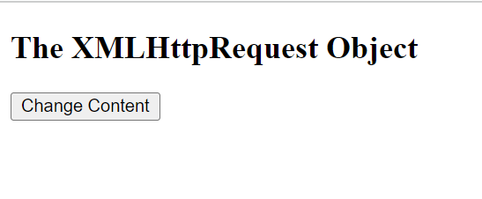
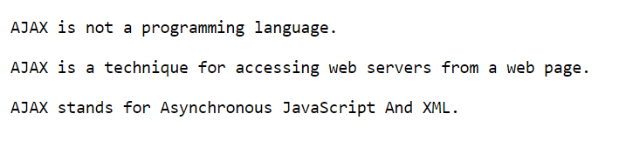
OUTPUT
Clicking the Button
Function Execution
Server Response Handling
Output Change
OUTPUT
21

Slide 22
Home
Photo
About Us
Contact
Safa Khan 015
01
Introduction to Bootstrap
02
History of Bootstrap
03
Setting Up Bootstrap
04
Bootstrap Grid System
05
Bootstrap Utilities
06
Bootstrap Customization
07
Advanced Bootstrap
08
Advantage of using Bootstrap

Slide 23

Introduction to Bootstrap
Bootstrap
An open-source front-end framework.
It includes HTML, CSS, and JavaScript components.
Key Features of Bootstrap
Buttons
Navbars
Forms Cards
Modals
Dropdowns
Tooltips
Carousels
Responsive Design
Grid System
Pre Styled Components
Mobile-First Approach
Base Style for Mobile
Responsive Breakpoints
Single Column - Grid System
Reusable Components
Modularity
Pre-Styled
Customizability
23

Slide 24



History of Bootstrap
Origin
Created by Mark Otto and Jacob Thornton at Twitter.
Originally named "Twitter Blueprint.“
A framework to encourage consistency across internal tools.
Versions
Known as Twitter Bootstrap
Responsive Design
Basic Components
12-Column Grid System
Addition of Components
Mobile-first Design
Customization Options
B2
Flexboxes
New Components
Better Theming
Removed jQuery Dependency
Added New Utilities
Improved Customization
24

Slide 25
Setting Up Bootstrap
Methods:
CDN
Include Bootstrap's CSS and JavaScript files directly from a CDN provider like BootstrapCDN, jsDelivr, or CDNJS.
2. Downloading Bootstrap Files
Download the Bootstrap files from the official website (getbootstrap.com) and
include them in your project directory.
<!-- CSS -->
<link href="https://cdnjs.cloudflare.com/ajax/libs/twitter-bootstrap/5.3.0/css/bootstrap.min.css" rel="stylesheet">
<!-- JavaScript -->
<script src="https://cdnjs.cloudflare.com/ajax/libs/twitter- bootstrap /5.3.0/js/bootstrap.bundle.min.js"> </script>
<!-- CSS --> <link href="path/to/bootstrap.min.css" rel="stylesheet">
<!-- JavaScript --> <script src="path/to/bootstrap.bundle.min.js"></script>
25

Slide 26
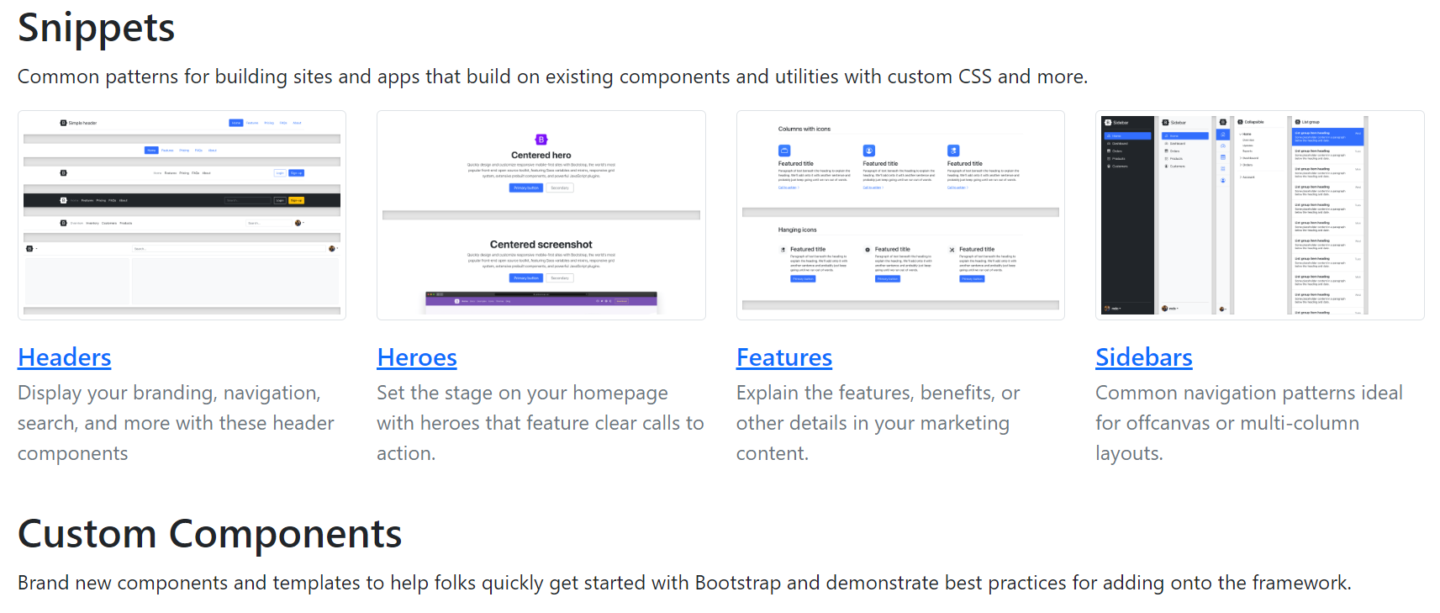
Setting Up Bootstrap
Package Managers
Install Bootstrap as a dependency using NPM.
Starter Templates
Use Bootstrap starter templates available on the official Bootstrap website or other online resources and customize it accordingly.
npm install bootstrap
26

Slide 27
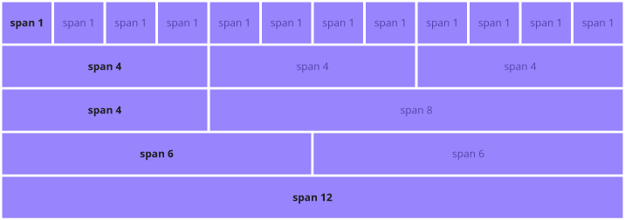
Bootstrap Grid System
Based on 12-column grid system.
Allows easy responsive and complex layouts.
Uses a combination of containers, rows and columns to align content.
Containers: .container and .container-fluid.
Responsive Breakpoints:
.col-: Extra small devices (portrait phones, less than 576px)
.col-sm-: Small devices (landscape phones, 576px and up)
.col-md-: Medium devices (tablets, 768px and up)
.col-lg-: Large devices (desktops, 992px and up)
.col-xl-: Extra large devices (large desktops, 1200px and up)
27

Slide 28
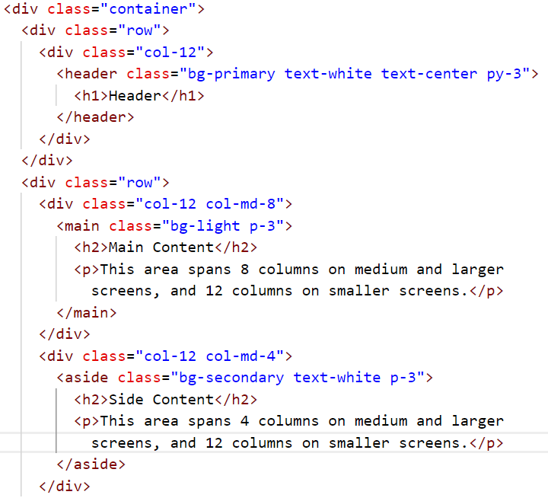
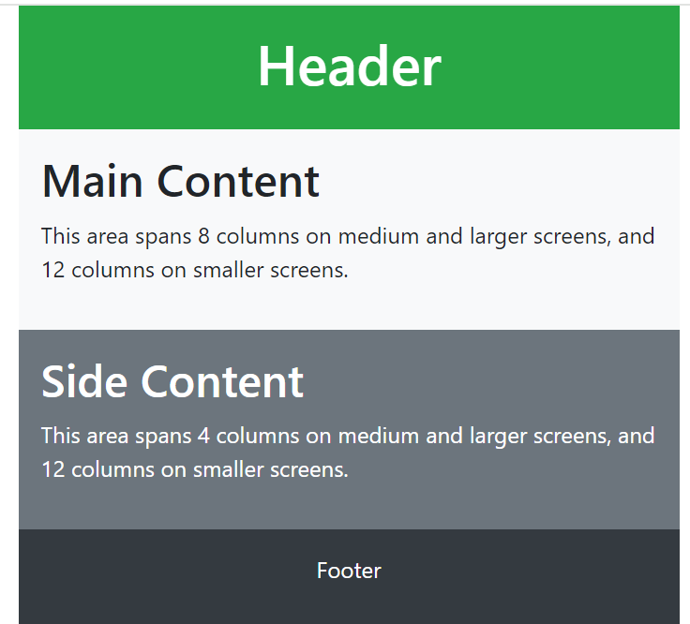
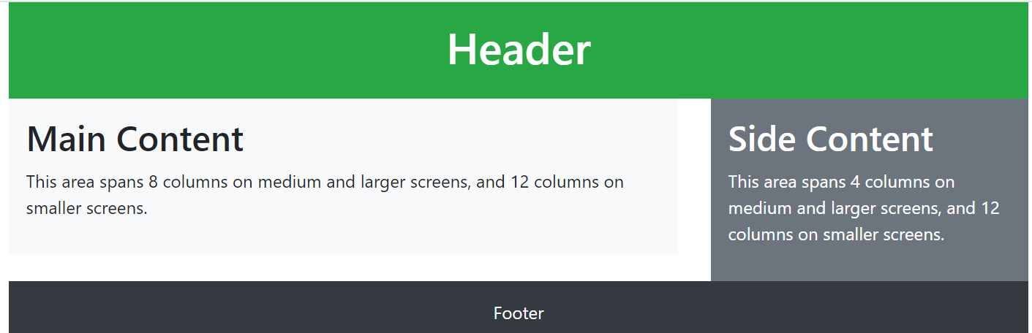
Example
Small Screen
.container-fluid
Large Screen
.container
28

Slide 29
Bootstrap Utilities
Offer various predefined styles and functionalities to streamline web development.
Utilities | Types
Spacing and Sizing | margin (m-) and padding (p-) | controlling sizes (w- & h-)
Colors and Backgrounds | applying color to text (text-) | background colors (bg-) | gradient backgrounds (bg-gradient-)
Borders and Shadows | adding borders (border, border-top, border-bottom) | box shadows (shadow-)
Typography | text alignment (text-left, text-center, etc.) | font weight (font-weight-bold, font-weight-normal) | text transformation (text-uppercase, text-lowercase, text-capitalize)
Flexbox | flex container (d-flex, flex-row, flex-column | -flex items (align-items-*, justify-content-*, order-*)
29

Slide 30


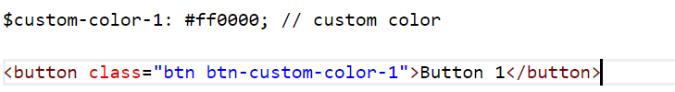
Bootstrap Customization
Syntactically Awesome Style Sheets (SASS)
Preprocessor scripting language interpreted or compiled into CSS.
Customize framework's variables and styles such as colors, spacing, typography, breakpoints etc. efficiently.
Take advantage of features like mixins and nesting.
Command:
Compile into CSS:
Link compiled CSS file in HTML :
npm install sass
sass custom.scss custom.css
<link href="custom.css" rel="stylesheet">
SASS file
HTML file
30

Slide 31

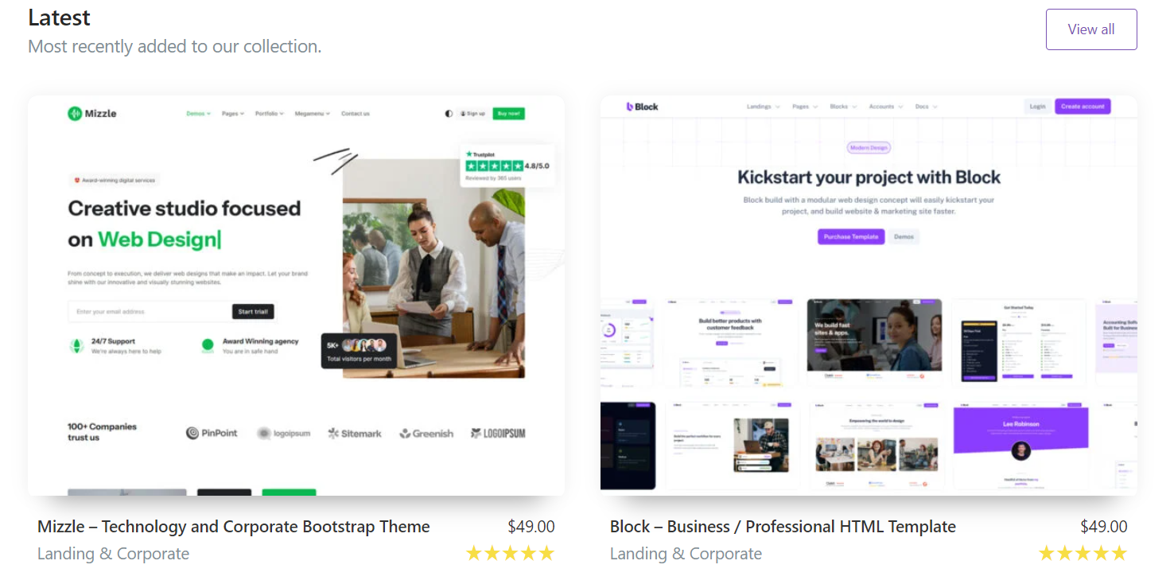
Advanced Bootstrap
Bootstrap Icons
A free and open-source icon library
Contains over 1,300 customizable SVG icons.
Theming Bootstrap
Allows creating custom themes by overriding default variables.
Can use third-party themes and templates.
Several paid themes are available on bootstrap.com.
31

Slide 32


Advantage of using Bootstrap
Rapid Development
Easy accessible components
Responsive Design
Built in queries
Improves user experience and accessibility
Consistency
Provides a unified set of styles and components
Ensures cohesive look
Save time and effort
Customizability
Allows for extensive customization
Cross browser Compatibility
Works across several browsers
Display consistent design on each
Community Support
Has a large and active community
Modify designs according to preferences
Provides wealth of knowledge and resources
32

Slide 33
Home
Photo
About Us
Contact
THANK YOU

